Slide 1
Dynamic Programming and Applications
Jyotiprasad Patil
Nikita Narwal
Harshit Goyal
Meenakshi Goyal

Slide 2
Dynamic Programming
Dynamic Programming is used in optimization problems. Like divide-and-conquer method, Dynamic Programming solves problems by combining the solutions of subproblems. Moreover, Dynamic Programming algorithm solves each sub-problem just once and then saves its answer in a table, thereby avoiding the work of re-computing the answer every time.
Two main properties of a problem suggest that the given problem can be solved using Dynamic Programming. These properties are overlapping sub-problems and optimal substructure.

Slide 3
Overlapping Sub-Problems - It is mainly used where the solution of one sub-problem is needed repeatedly. The computed solutions are stored in a table, so that these don’t have to be re-computed. Hence, this technique is needed where overlapping sub-problem exists.
For example, Binary Search does not have overlapping sub-problem. Whereas recursive program of Fibonacci numbers have many overlapping sub-problems.

Slide 4
Optimal Substructure - A given problem has Optimal Substructure Property, if the optimal solution of the given problem can be obtained using optimal solutions of its sub-problems.
For example, the Shortest Path problem has the following optimal substructure property −
If a node x lies in the shortest path from a source node u to destination node v, then the shortest path from u to v is the combination of the shortest path from u to x, and the shortest path from x to v.

Slide 5
0-1 Knapsack Problem
In 0-1 Knapsack, items cannot be broken which means the thief should take the item as a whole or should leave it.
0-1 Knapsack cannot be solved by Greedy approach. Greedy approach does not ensure an optimal solution.

Slide 6
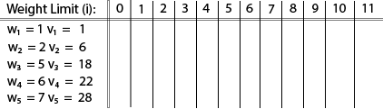
Example - 1
Example: The maximum weight the knapsack can hold is W is 11. There are five items to choose from. Their weights and values are presented in the following table:

Slide 7
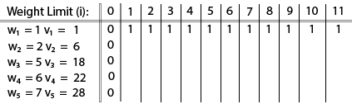
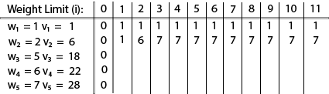
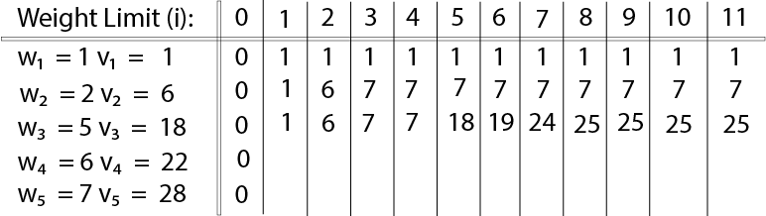
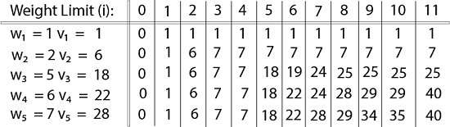
V [i, j] = max {V [i - 1, j], vi + V [i - 1, j -wi]

Slide 8
Job Sequencing
with Deadline

Slide 9
Problem Statement
• There are ‘n’ jobs are given with their profits and deadlines.
• Profit is earned if and only if a job is done or complete within its deadlines.
• It is supposed that each job needs one unit of time to complete the job.
• Aims to find out the set of jobs that provides maximum profit.

Slide 10
Algorithm
1) Sort all jobs in decreasing order of profit.
2) Iterate on jobs in decreasing order of profit.For each job , do the following :
a)Find a time slot i, such that slot is empty and i < deadline and i is greatest.
Put the job in this slot and mark this slot filled.
b)If no such i exists, then ignore the job.

Slide 11
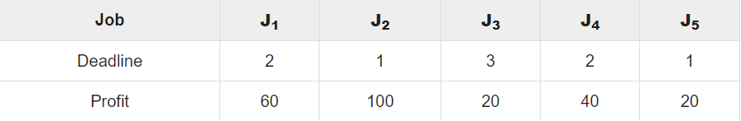
Example
Each job is associated with a deadline and profit.

Slide 12
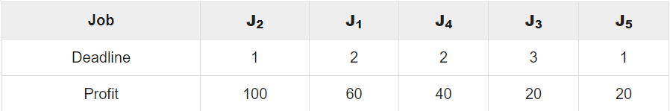
The given jobs are sorted according to their profit in a descending order.
After sorting, the jobs are ordered as shown in the following table.

Slide 13
Number of ways problem..

Slide 14
Problem Statement..
• There are ‘n’ steps are given.
• It is supposed that you have to find out the number of ways to reach the steps.
• Aims to find out the steps to reach the desired step.

Slide 15
Algorithm...
Create an array of size n + 1 and initialize the first 2 variables with 1,2 2
Run a loop from 2 to n.
For each index i, computer value of ith position as dp[i] = dp[i-1] + dp[i-2]].
Print the value of dp[n], as the Count of number of ways to cover a distance.

Slide 16
Approach..
There are n stairs, and a person is allowed to next step, skip one position or skip two positions. So there are n positions. The idea is a way of forming the recursive function. To reach position i, a person has to jump either from i-1, i-2 or i-3 position where i is the starting position.

Slide 17
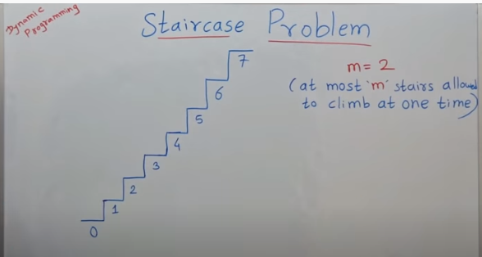

Slide 18
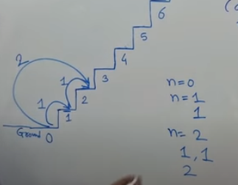

Slide 19
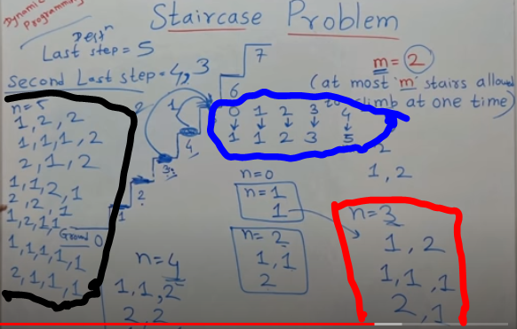

Slide 20
Matrix Chain Multiplication

Slide 21
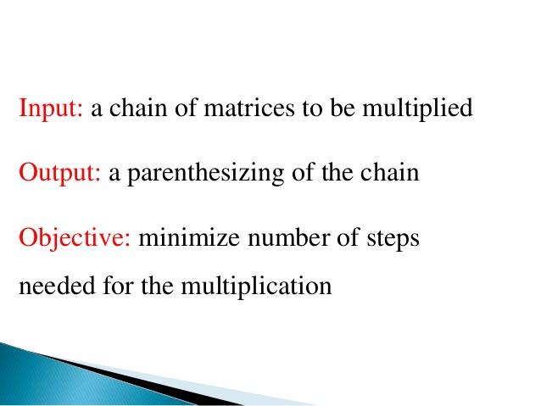

Slide 22
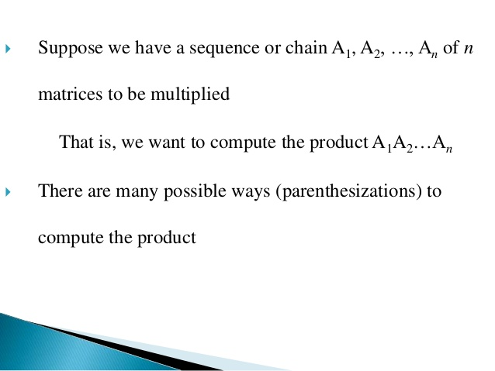

Slide 23
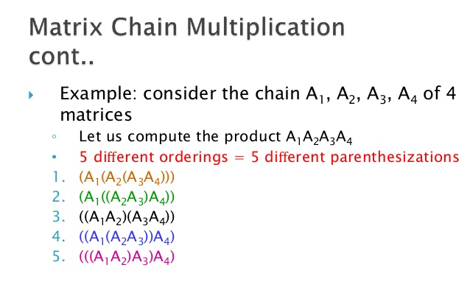

Slide 24
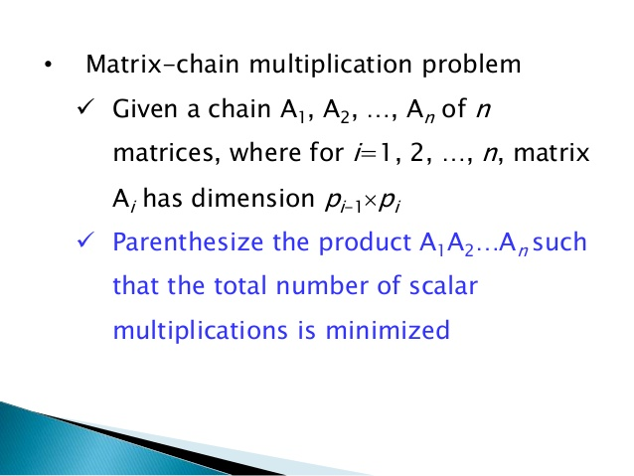

Slide 25
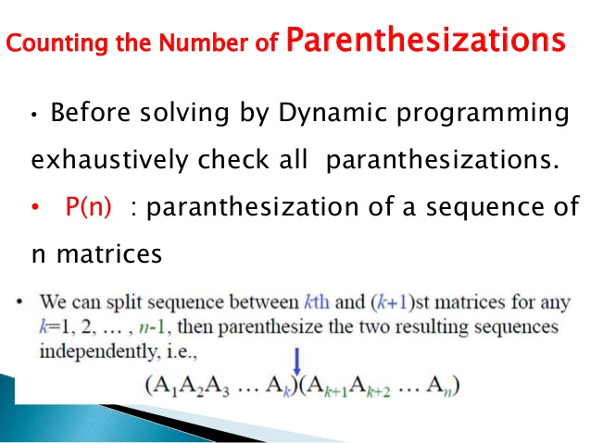

Slide 26
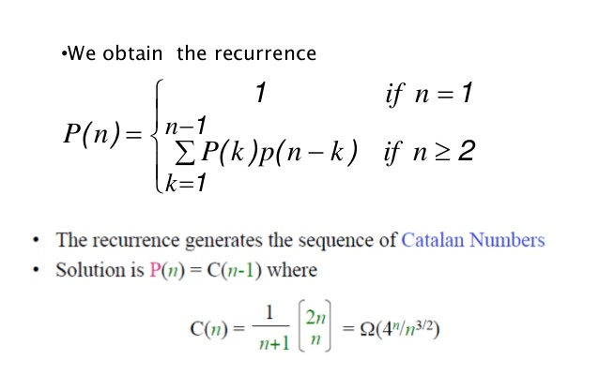

Slide 27
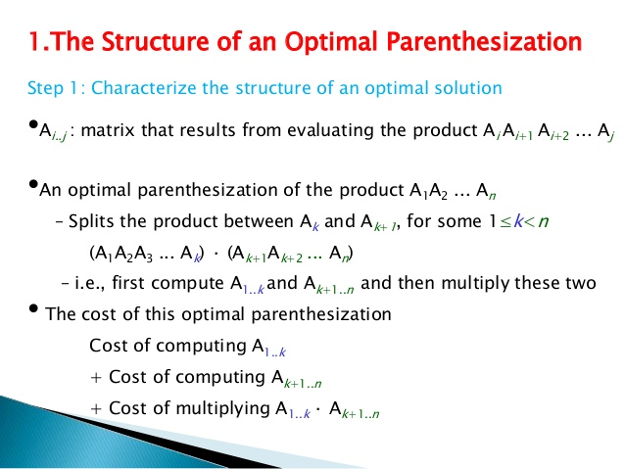

Slide 28
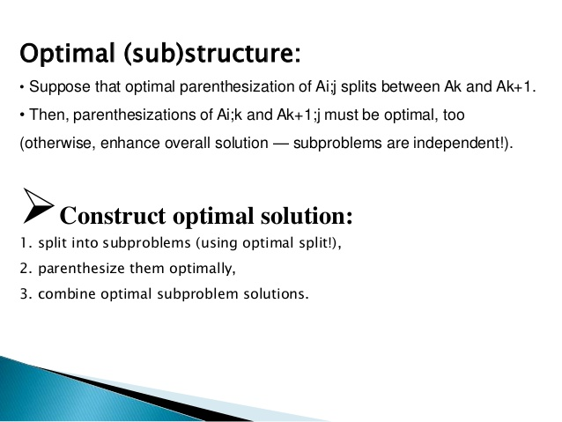

Slide 29
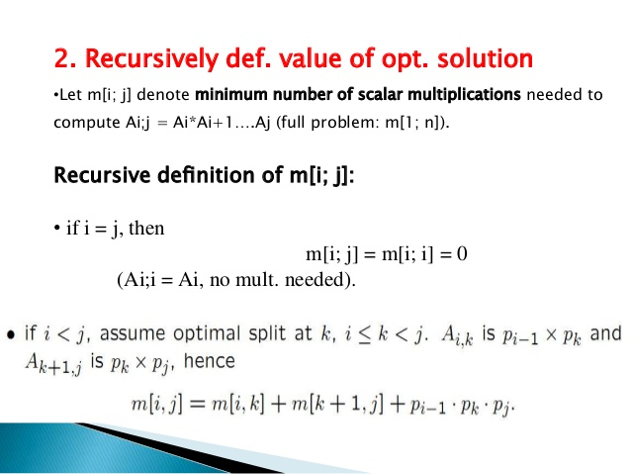

Slide 30
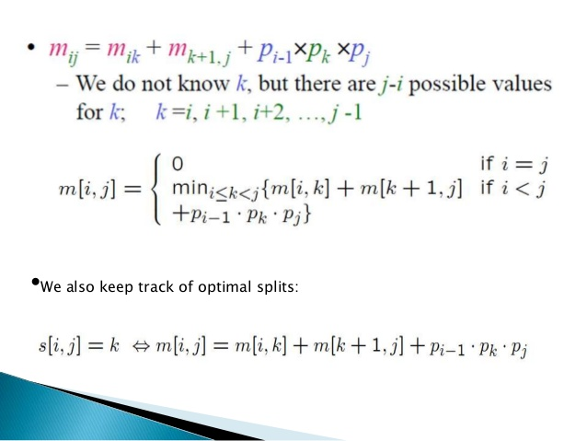

Slide 31
Algorithm optimal paranthesis
Optimal paranthesis (S,i,j)
If i= j
Then print “Ai”
Else print “(“
Print optimal paranthesis(S,i,S[i,j])
Print optimal paranthesis(S,i,S[i,j]+1,j)
Print “)”

Slide 32
Thank you..

